Slide 1
Update on
SERFF Modernization
Bridget Kieras, Sr Manager, ITG
Lauren Bandle, Business Analyst

Slide 2
Modernization Overview -
Drivers for Change
Operational Efficiency
Product Complexity & Innovation
Technological Advances

Slide 3
Modernization Overview -
Key Capabilities
User Managed Customizations
Filing Preparation and Submittal
Consistent and Efficient Filing Review
Communication and Collaboration Tools
API Integration with Business Partners and NAIC Products
Workload Management
Robust Search and Reporting

Slide 4
Out Now - Search and Document Compare
Introduced new search capabilities to the existing application
Significantly improved response times even for large searches
Document search will be available to all users
Pilot in progress
A feature to support comparison of two PDFs introduced in December
Additional search fields coming by end of this quarter

Slide 5
Coming Soon! Tableau Reporting
SERFF data moving to Enterprise Data Warehouse (EDW)
  Better support for reporting
  Moves load off operational database
Tableau Dashboards are a key deliverable
Users will log into NAIC's Tableau site during transition
Additional data access and reporting tools under evaluation

Slide 6
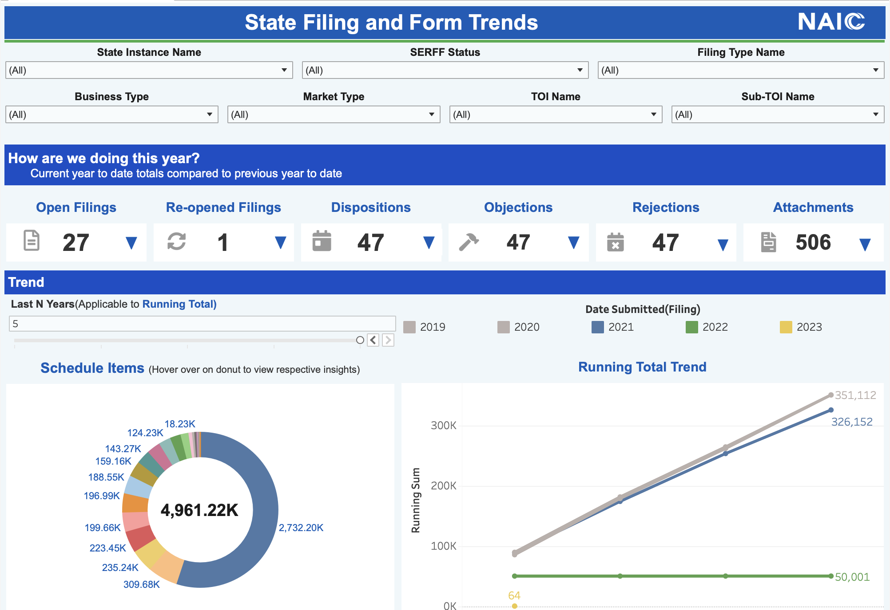
Example – Providing Value, Not Just Numbers
Filter to target results
Highlight the important data
Give data context

Slide 7
New Platform Headlines
Project Timeline
Interstate Compact filings will be the first to move to the new platform
Life, P&C, Health and finally Plan Management
Long requested enhancement are being delivered
Fee Calculation
Multiple TOIs & SubTOIs
Ability to change TOIs & SubTOIs
Emails

Slide 8
New & Improved
Self-service user management
Streamlined Correspondence & Filing Updates
Field level state business rules
Form number & form type validation
Dashboards & user customization

Slide 9
Get Involved!
Participate in monthly PSC Calls
Sign up for focus groups
Send us your ideas, questions and pain points!
Lauren Bandle | Bridget Kieras
Business Analyst lbandle@naic.org | Product Manager bkieras@naic.org
https://www.serff.com/serff_modernization.htm
Notes:
The PSC is a great way to stay up to date and provide input to the project. Each month we provide an update on the project, show or describe new features, and conduct an "engagement activity" to gather input from participants. The PSC is made up of 20 members but interested parties are welcome.
We will be conducting various focus groups throughout the project. Focus groups are small by design and concentrate on specific topics. They may meet once or several times. They are often involved in user acceptance testing as well. Just contact us if you are interested.
We also welcome your ideas and input at any time! Just email Bridget and Lauren.
The website has some basic information and we will be working to add more as we get closer to the production date of the project.

Slide 10
Get Ready!
Watch for emails and SERFF Alerts! Be sure to respond when asked for information or action.
Review and clean up your users.
  Deactivate as needed.
  Update roles where applicable.
  Ensure all email addresses are valid.
Identify point people for early training, migration questions, and other communication.
  Industry is too large for effective communication to everyone.
  NAIC will rely on point people to help share information and funnel feedback.
  We will reach out when we are ready to start collecting this information.
Document and review SERFF specific processes to identify potential disruptions.
Notes:
While the production release is still a ways off, there are things you can do to get ready.
Over the coming months we'll begin to release more information about training and other release activities. There may be questions about migration or different configurations. Be sure to keep an eye out for emails and SERFF Alerts and please response to requests for information.
For both training purposes as well as our new user management module, it is very important that we have accurate and up to date user information. Work with the person(s) authorized to manage your users. Make sure to deactivate people who should no longer have access. Confirm roles are correct. Ask all your users to update their information, especially their email address. Note that occasionally you may see NAIC names on your instance – that is just our support and implementation staff working to support you in production.
We have a pretty good handle on key contacts for states but that is a much harder thing to do with industry because there are so many more companies. We will likely ask each industry instance to appoint one or two key contacts. We'll relay information to those contacts and ask them to ensure their users receive the information. Be thinking about this and your internal communication. We will reach out when we are ready to get that contact information.
The new system will be very different from what we have today. Be sure you have your internal SERFF processes and dependencies documented so that as you learn about the new system, you are prepared to adapt them and avoid disruption.

Slide 11
Questions?

