Slide 1

Using Artificial Intelligence to Enhance Insurance Product Review in SERFF Modernization
Presenter – Bridget Kieras
Senior Manager
Bkieras@naic.org
Notes:
Introduce topic and goals of session
We’re here today to talk about how the SERFF Mod project is incorporating machine learning concepts to improve compliance and review of form and rate filings
Along the way, we hope you’ll learn a bit about ML terms and concepts and give you things to think about, especially if you are a SERFF user

Slide 2

Machine Learning
Machine learning is a subfield of artificial intelligence that gives computers the ability to learn without explicitly being programmed.
https://mitsloan.mit.edu/ideas-made-to-matter/machine-learning-explained
Notes:
5 MIN (15/50)
We will clarify we are not experts. We are “technology savvy business people.”
But we have begun to learn and want to share what we have learned so far. Important for business people to gain a basic understanding.
AI vs ML
AI is a concept – machine learning is one way that concept is implemented
machine learning is AI, not all AI is machine learning
The key is that AI learns and adapts to perform tasks that are usually performed by a human
Machine learning is the largest and most commonly encountered category of AI and what we plan to do in SERFF falls into the ML category
Machine learning relies on use of algorithms trained on data and related to a specific task or use case – these create a machine learning models that can perform the task
AI and Machine learning are pretty much everywhere today - even when you don’t know it.
My Alexa – understands my questions (mostly!) and makes suggestions
Online help chatbots
The filter on Gmail
Did you know?
They are developing ML models to look for cancerous growths on Xrays
ML is used to detect credit card fraud
Used to forecast and problem solve supply chains
AI is making our lives better but it isn’t without issues and concerns. We’ll talk about those a bit later in the presentation

Slide 3
Outcomes of Machine Learning
Descriptive
Predictive
Prescriptive
Notes:
All filings to be migrated
Concurrent platform usage for some users
Some aspects may remain in legacy for a time (industry manage companies)
“The function of a machine learning system can be descriptive, meaning that the system uses the data to explain what happened; predictive, meaning the system uses the data to predict what will happen; or prescriptive, meaning the system will use the data to make suggestions about what action to take,”
These can often work together, so what you see is a blend of these types of analytics
Use Case: Traffic Management
Descriptive AI uses historical data to provide insight into factors and locations of traffic bottlenecks.
Predictive AI can combine the historical data and real time data to predict traffic patterns and congestion levels for the next day
Prescriptive AI can then recommend what actions to take to alleviate congestion, like adjust the timing of stoplights or rerouting public transportation
SERFF Example
Descriptive – generate a filing summary
Predictive – will this be approved
Prescriptive – here is what you need to fix

Slide 4
Possibilities for SERFF
Document Classification & Data Extraction
Filing and Review Checklists
Help Chatbot
Correspondence Assistance
Notes:
All filings to be migrated
Concurrent platform usage for some users
Some aspects may remain in legacy for a time (industry manage companies)
One of our goals for the SERFF Modernization is to implement machine learning in a variety of ways. We are still discovering and evaluating what those features might look like. We do see this as a journey. Our early releases will lay the foundation on which we will continue to build. On this slide we’ve listed a few that we’ve identified. The first will be a reality for form filings with our first release next summer, and the second is probably the largest and most significant ML capability we foresee. DISCUSS EACH OF THESE BRIEFLY.

Slide 5
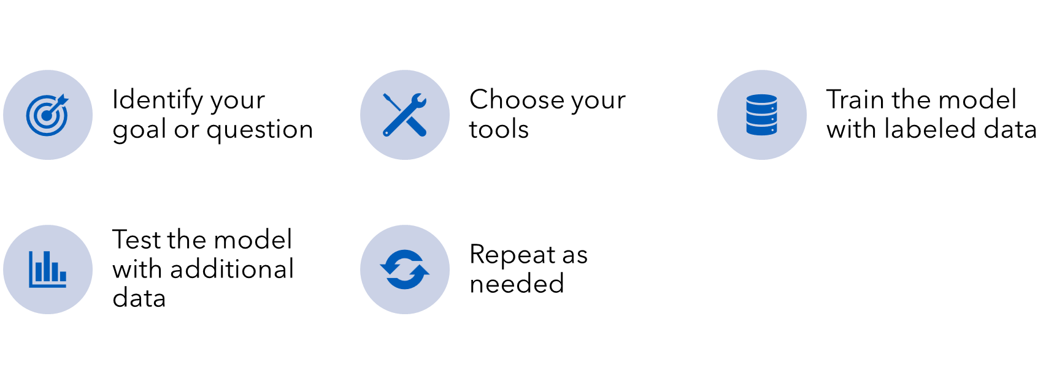
Training the Model
Notes:
We’ve already tackled our first ML use case for the form schedule.
Current state in legacy
How it will work in SMOD
The key benefits here are reduced manual effort by companies and states and improved data integrity. We think that second part is key for how we want to build in rules to help with form review.
I’d like to describe how we did this as an illustration of how a machine learning model is trained.

Slide 6

Considerations for ML in SERFF
For the state
  Wide & shallow or narrow & deep
  Human time and expertise to train and maintain
  Autonomy vs oversight
  Workforce impacts
For the NAIC
  Security, privacy and legal
  Technology choices
  Staffing
  Best practices
Notes:
From the NAIC side, we regard AI/ML as a powerful technology that we can introduce to help regulators in a number ways, SERFF product review being just one. But we also recognize that the technology is still relatively new and constantly evolving.
There is certainly a lot to discuss in the security, privacy and legal arenas. We’ve started internal discussion with NAIC security and legal staff.
We understand our responsibility to provide reliable and accurate tools to regulators – we take that pretty seriously. So we are monitoring and learning; we assess tools and experiment. We lean on and bring in experts and seek partnerships.
Specific to SERFF and on a larger scale, we are certainly discussing what it will take to build and maintain these types of systems. This isn’t something you put into production and walk away from. And we think about best practices – how can we support states that want to use machine learning? What can be leveraged across states? What is the best approach to training?

Slide 7
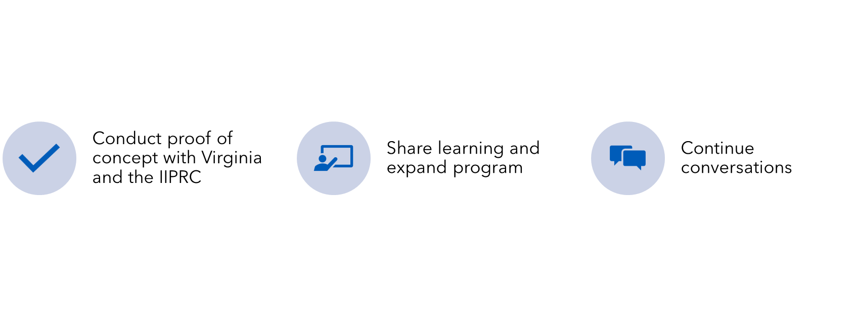
What's Next
Notes:
Lots to think about! It’s a big lift, but pretty exciting. So what’s next?

Slide 8
Questions?
Thank you for attending!

