Slide 1
Product View
Lauren Bandle

Slide 2
Current Challenges
Products are submitted within multiple filings – both initial and updates.
Regulators often need the context of previously submitted information to complete the current review.
Insurance Product
Initial Filing
Filing 2 (Updates)
Filing 3…

Slide 3
Current SERFF Capabilities
SERFF provides some linking capabilities (previous tracking number, associated filings, etc.)
However,…
Gaps in capabilities lead to redundant documentation being added to multiple filings.
Filing 1
Filing 2
Filing 3
SERFF TRACKING NUMBER
Questions:
What is a Product?
Is this something the regulators or industry defines?

Slide 4
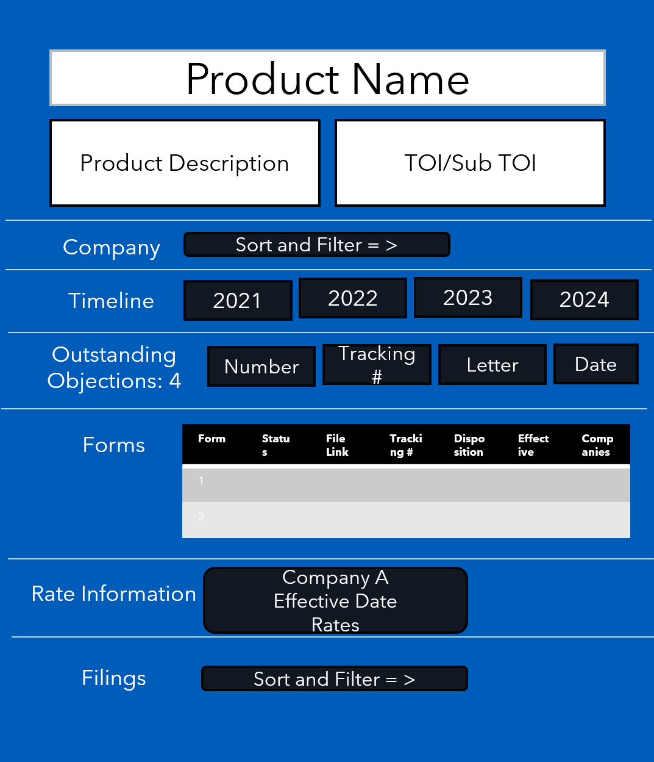
Proposed Solution: Product View
A consolidation of information from all related filings into one view.
Displays relevant product related data.
Easy navigation to related filings.
Questions:
What data would you like to see in a product view?
How would you benefit from a product view?

Slide 5
Moving Forward
Already in place: Added type-ahead to Product Name field to cut down on common errors.
Questions:
How do you know what product a SERFF filing is a part of?
How do we work backwards through existing filings to group them into products?

Slide 6
Survey
Please answer this survey and feel free to add your ideas, comments or suggestions.

Slide 7
Thank you!

