Slide 1
SERFF Modernization State Workshop
Training and Support

Slide 2
Training and Support

Slide 3
Training Methods
Live webinar
Recorded group training
Specific how-to videos
In-person training
Knowledge articles

Slide 4
Training Topics
Overview
Topic-based
Q&A
This Photo by Unknown Author is licensed under CC BY-SA

Slide 5
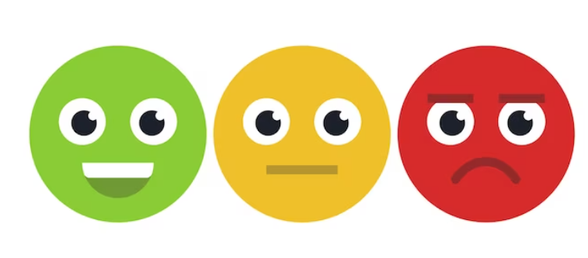
Support Methods
Help Desk
Tier 1 vs. Tier 2
In SERFF
Release Notes
Known Issues
Tutorials
User’s Manual

Slide 6
Support Topics
Customer Service Portal
In SERFF Tips
Chat
Other Ideas?

Slide 7
Questions and Contact Us
SerffModernizationQuestions@naic.org

